Slide 1

Safety floater
IoT group project for coastal tourism
Blue Growth
Daniele Bufalieri, Marco Calamo, Ivan Giacomoni

Slide 2
What is the problem?
The problem is the security of swimmers because of the boats that do not respect the safety distance from the coast.
It is a threat for the tourists and also for the environment because the pollution near the shore.
There is not a direct communication to the authorities

Slide 3
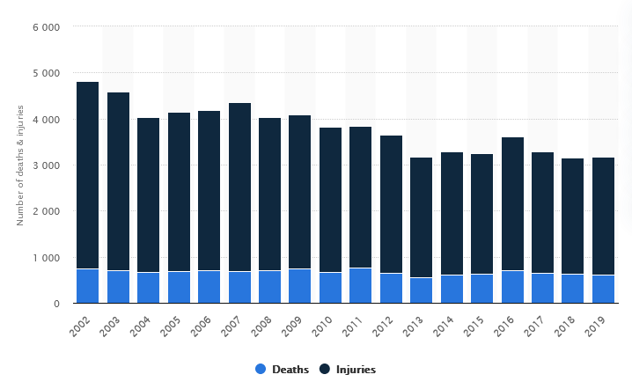
Boat accidents FROM 2002 TO 2019

Slide 4
Key functionalities
Real time reporting to authorities of violations
Create a safer holiday for tourists
Improve water quality near the shore
Decrease number of accidents
Provide an user friendly dashboard in order to monitor violations

Slide 5
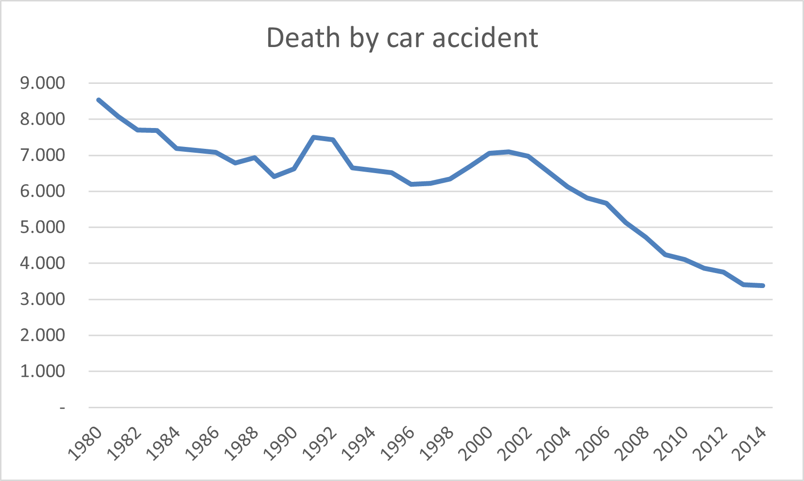
Collective intelligence
Our purpose is to replicate this trend of death by car accident since autovelox was introduced, but in the context of accident caused by boats introducing our system in order to prevent an increasing number of deaths.

Slide 6
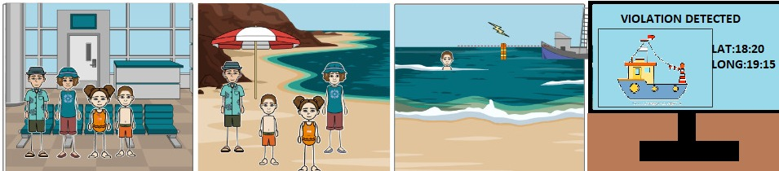
Scenarios
Above we can see a typical use case: Bob wants to enjoy a holiday with his family, so they go to the airport in order to take a plain for Sardinia. When they arrive there, they are ready to enjoy some days at a beautiful beach. One day, however, while his son is swimming in the water nearby, Bob sees a boat approaching too close to safety line, but thanks to the Safety Floater system control he will be immediately alerted by by a sound notification, and in the meanwhile a picture of the boat will be available on the dashboard.

Slide 7


Constraints
Not considered
Satisfied
All sensors are constantly sampled
Detection of false positives
Movement of the floater due to rough sea
Need of using waterproof sensors and custom shaped buoy
Solar panels in order to improve the battery life
Power consumption management

Slide 8
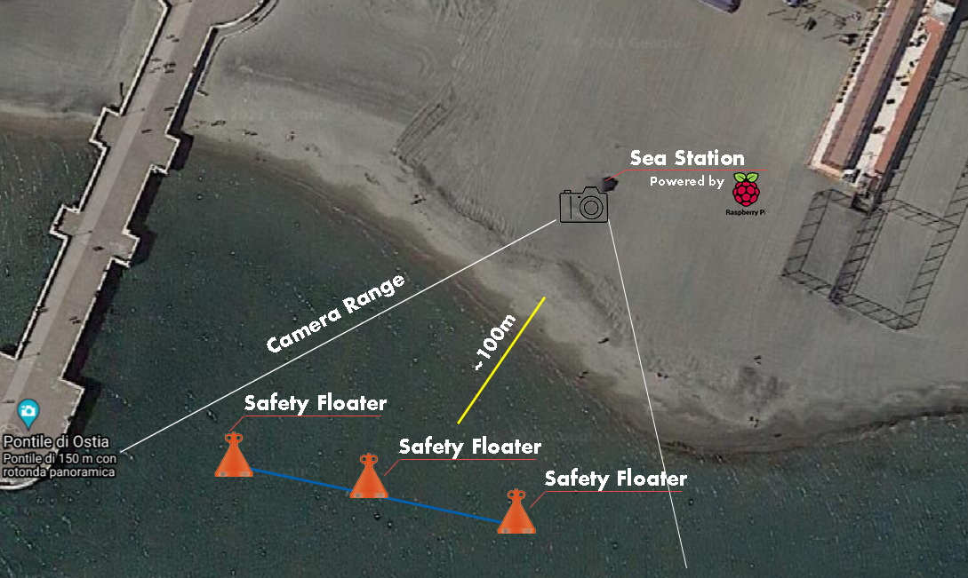
DEPLOYMENT
4 m
4 m

Slide 9
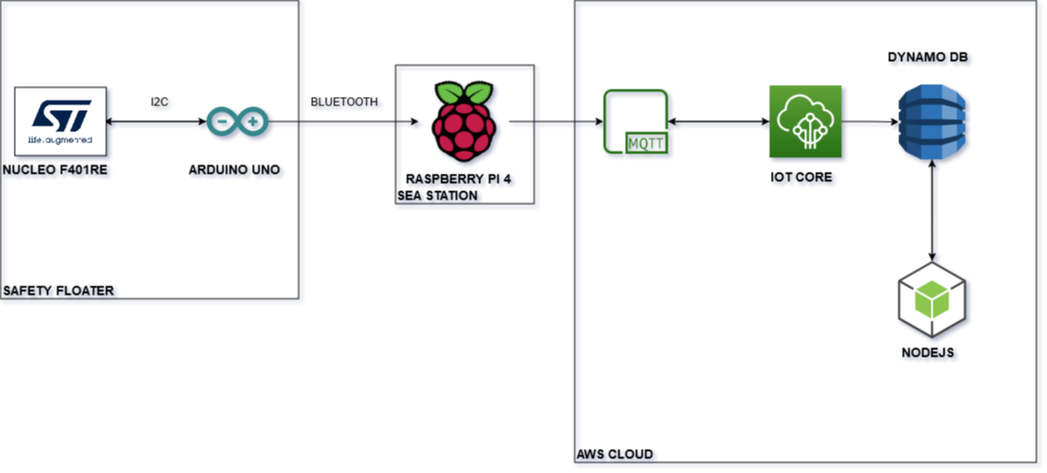
IOT ARCHITECTURE: DETAILED SUMMARY

Slide 10
SAFETY FLOATER
4 m
4 m

Slide 11
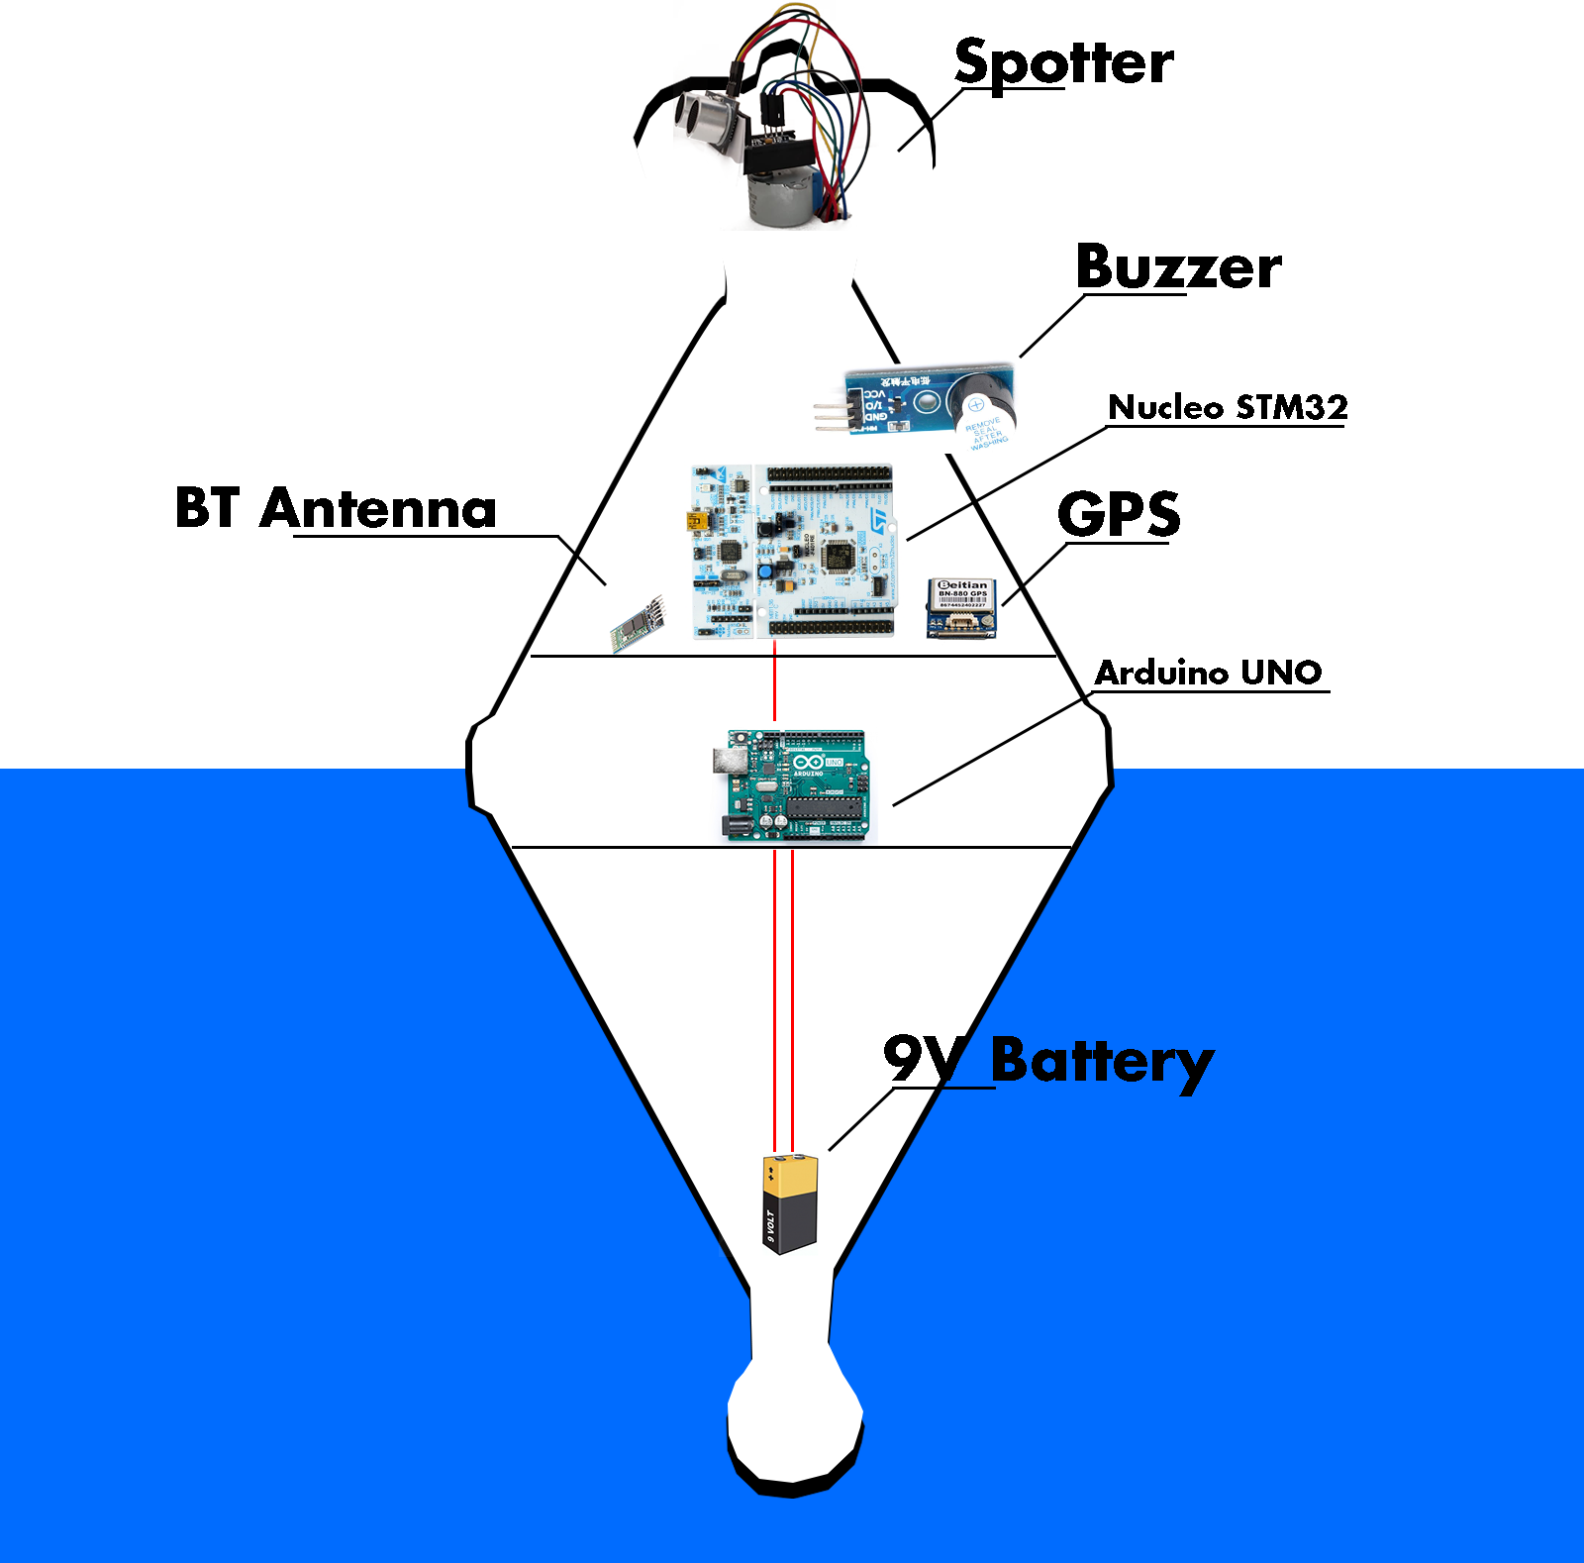
SAFETY FLOATER VIEW
In this version we used an Arduino Uno board in order to simplify the prototyping step
The spotter is our approach to detect the violations and keep the correct orientation also in the rough sea
The battery is on bottom in order to have a stabilized structure

Slide 12
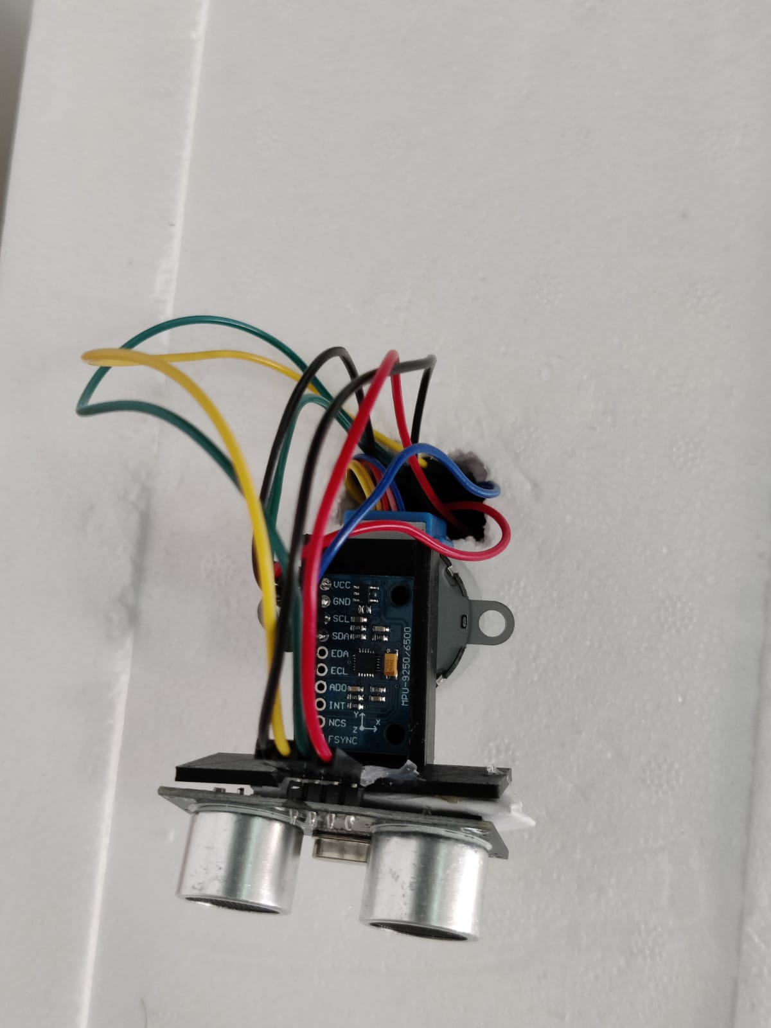
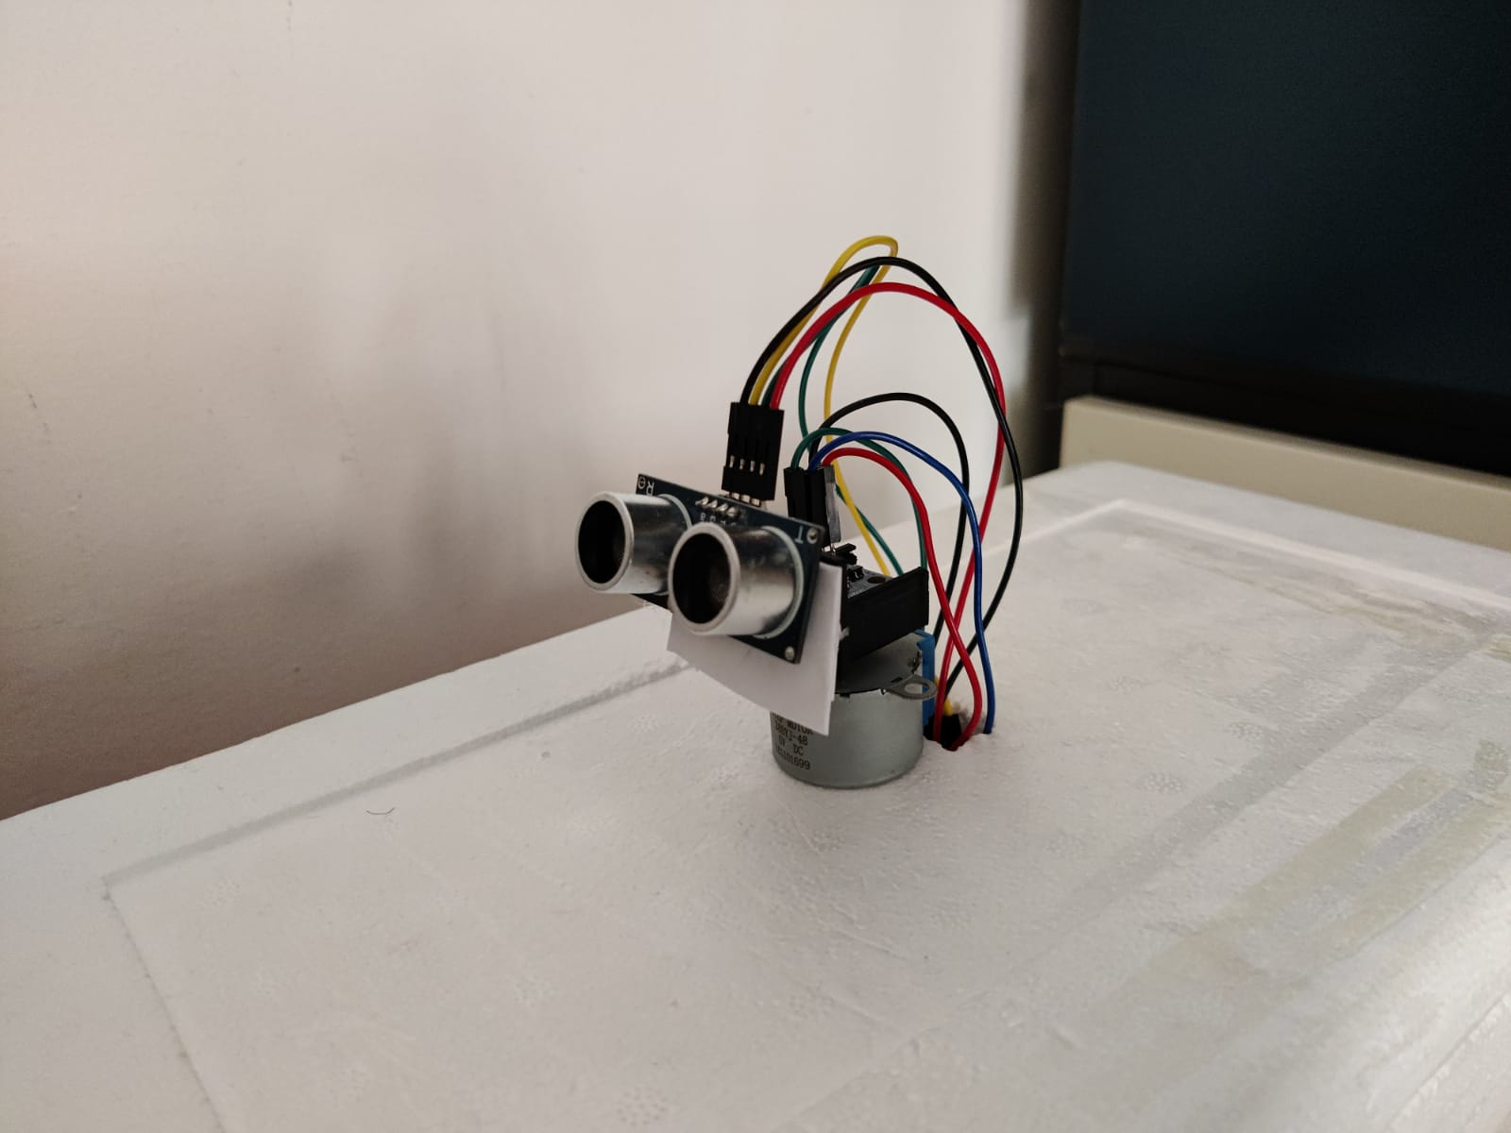
SPOTTER VIEW
MPU-9250 GYROSCOPE
HCSR-04 PROXIMITY SENSOR
STEPPER MOTOR

Slide 13
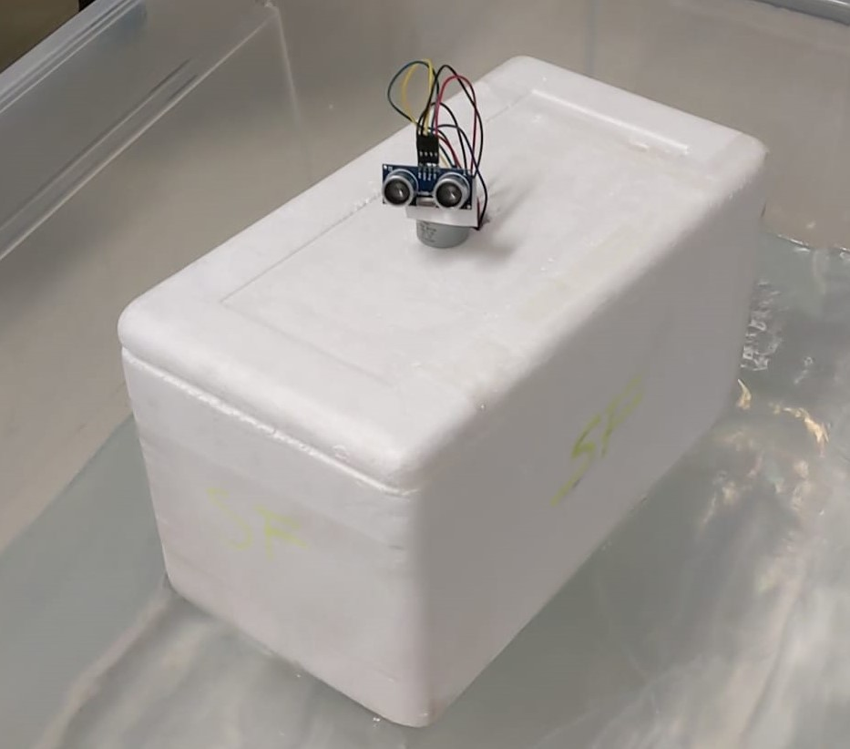
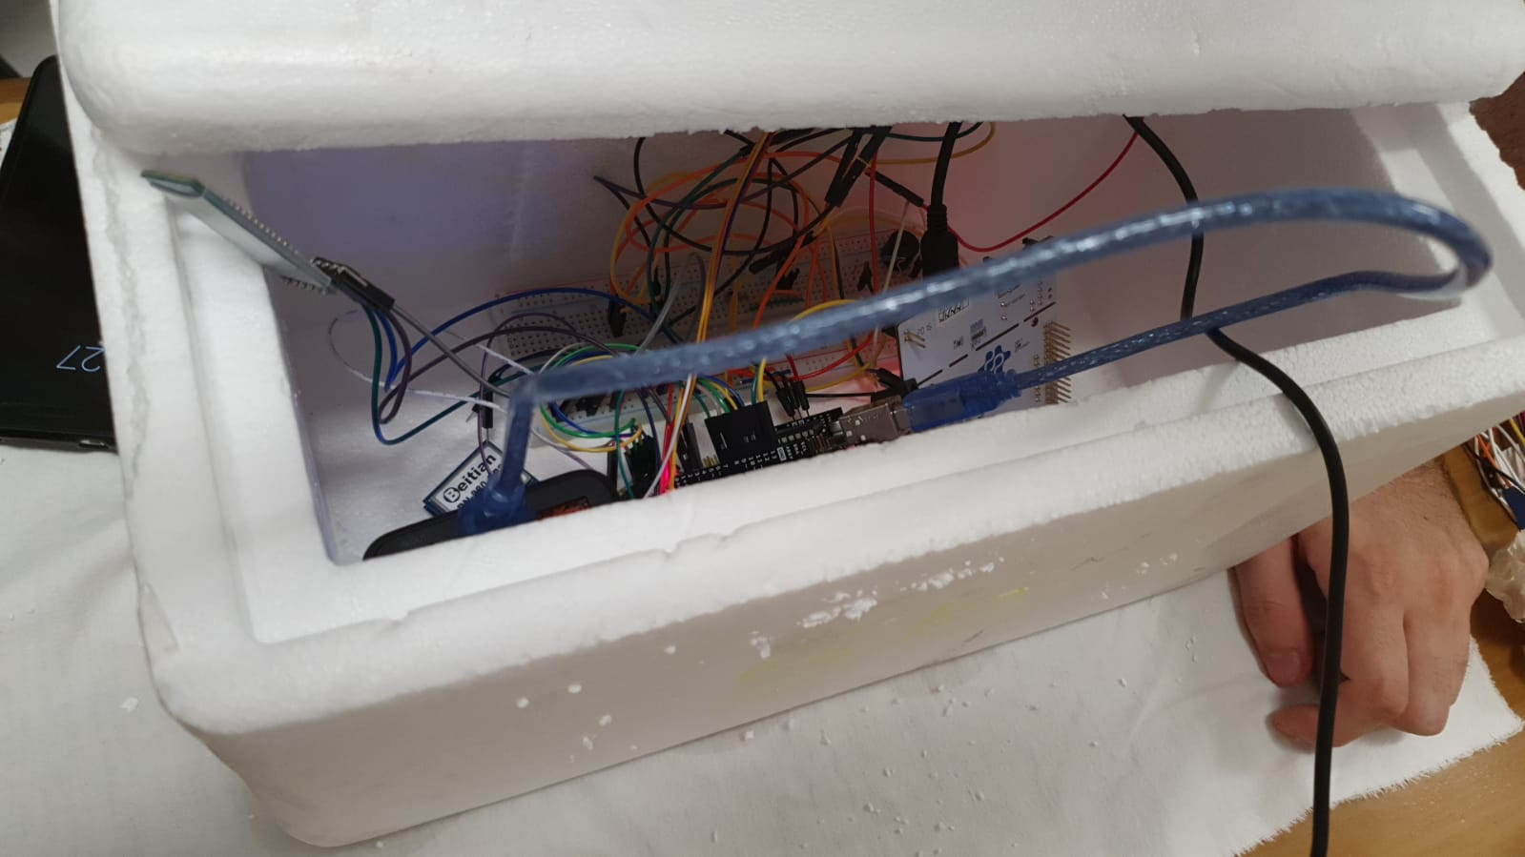
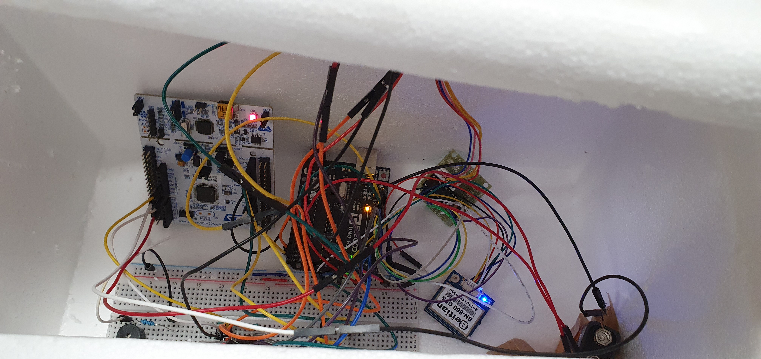
SAFETY FLOATER PROTOTYPE

Slide 14
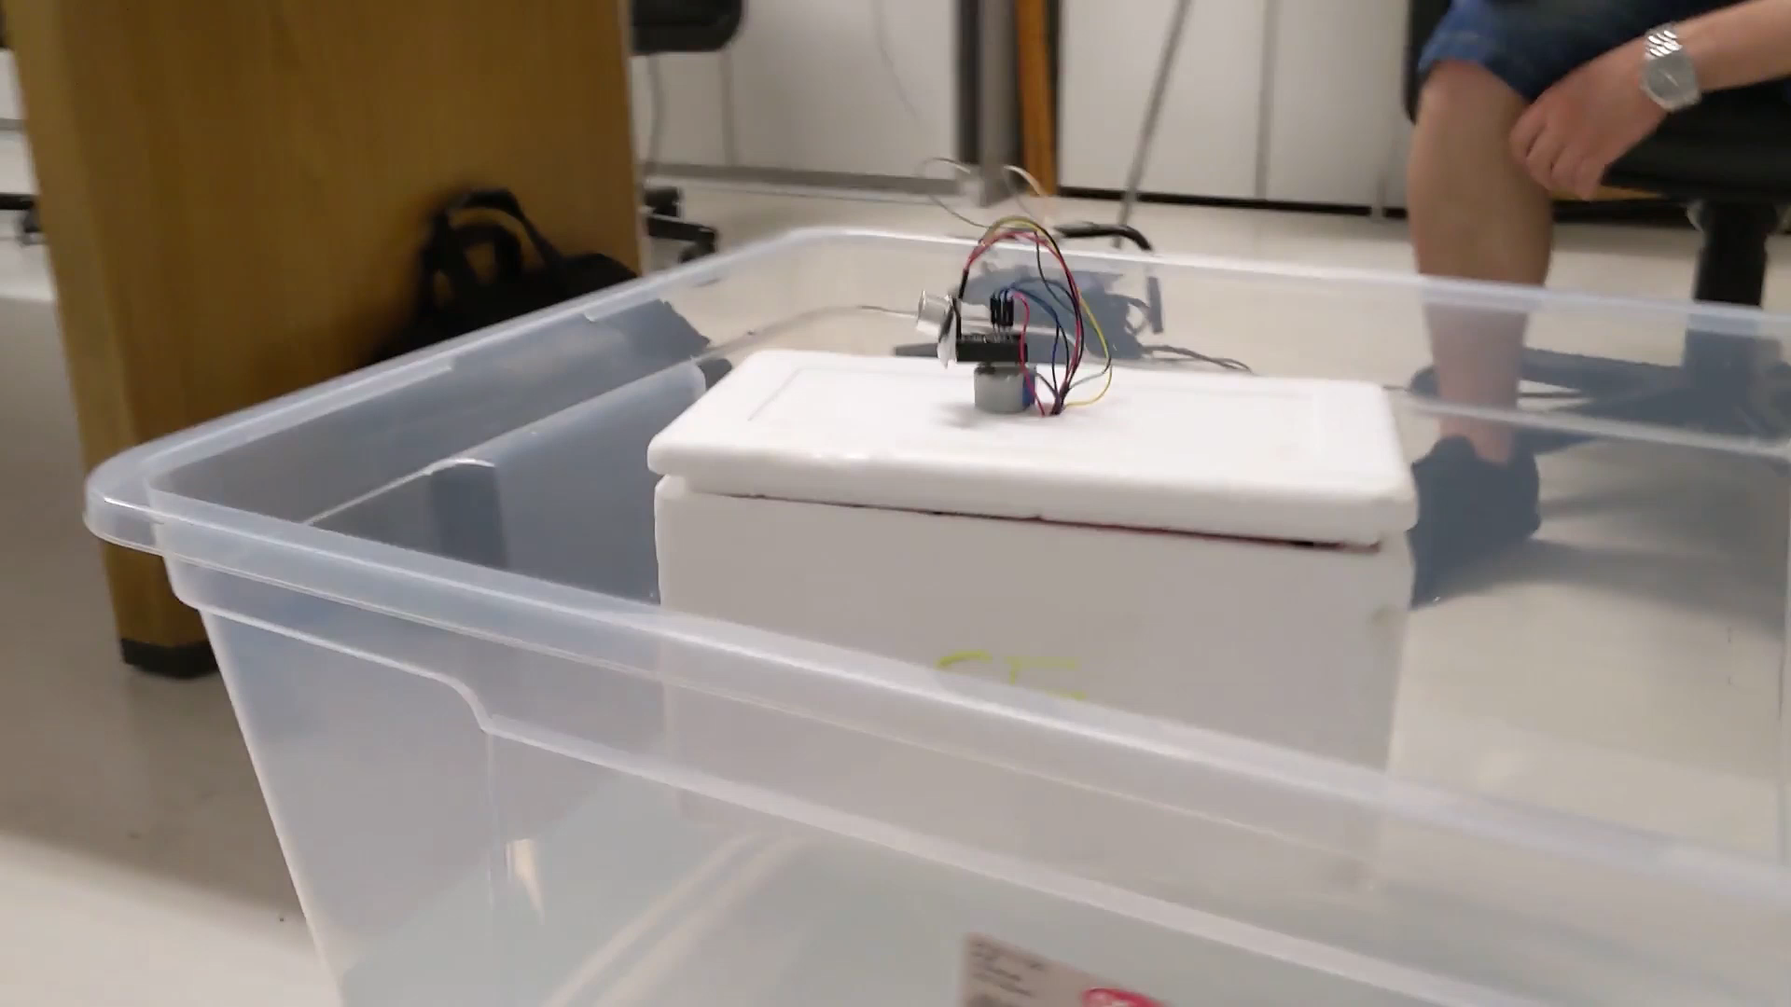
SAFETY FLOATER: FUNCTIONALITIES
BOAT DETECTION MECHANISM
ORIENTATION CONTROL MECHANISM
POWER MANAGEMENT MECHANISM

Slide 15
BOAT DETECTION MECHANISM
SAFETY FLOATER
SEA STATION
CLOUD
SOMETHING DETECTED
WAIT FOR DETECTION
BUZZER SOUND + NOTIFICATION SENDING TO SEA STATION
*
* We send latitude and longitude of the buoy in order to calculate the boat position with an accuracy of ± 4 meters
NO
UPLOAD TO DASHBOARD
PICTURE + CNN ANALYSIS
IS BOAT?
YES

Slide 16
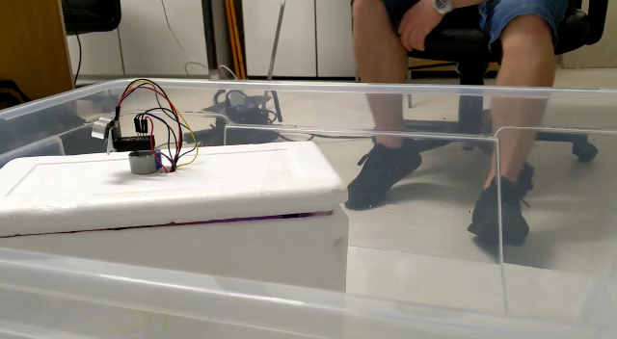
ORIENTATION CONTROL MECHANISM
Purpose: make the proximity sensor on the top of the spotter keeping the correct orientation with respect to the point where the boats are supposed to pass
A better orientation means a better probability to detect a boat, and so a better effectiveness
Gyroscope and compass of the MPU-9250 sensor are used to implement this functionality

Slide 17
POWER MANAGEMENT MECHANISM
High power consumption mode: the sea is calm, and we sample from the gyroscope every 100 μs, because is the most power demanding, while other sensors need to be constantly sampled
Medium power consumption mode: the sea is in mild conditions, it is less probable that boats will come, so we can sample the gyroscope every 10 seconds, while other sensors need to be constantly sampled with larger delays
Low power consumption mode: the sea is rough, it is almost impossible that boats will come, so we can sample the gyroscope every one minute, while other sensors need to be constantly sampled with even larger delays

Slide 18
POWER MANAGEMENT TESTING METRICS
We did 3 experiments on the Iot-lab platform, one for each mode, and we kept the system running for 30 minutes each
We simulated the passive situation on which there wasn't a boat that crosses the safety line
The input of the power management system is the acceleration measured from the MPU-9250 accelerometer along the z-axis, because it can tell us informations about the conditions of the sea

Slide 19
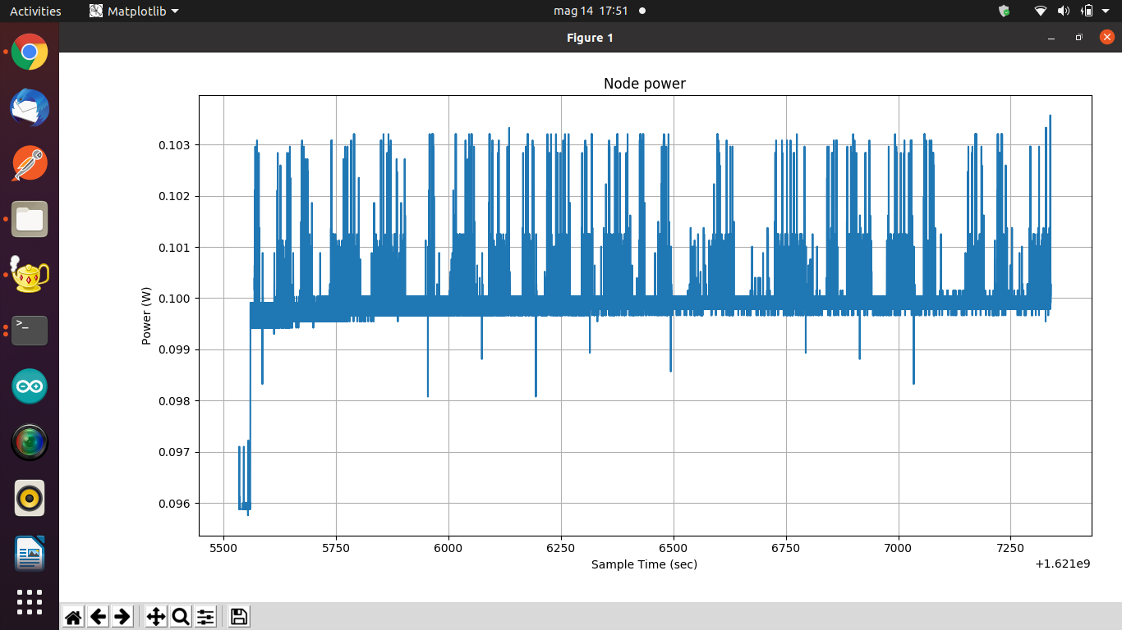
HIGH POWER CONSUMPTION mode

Slide 20
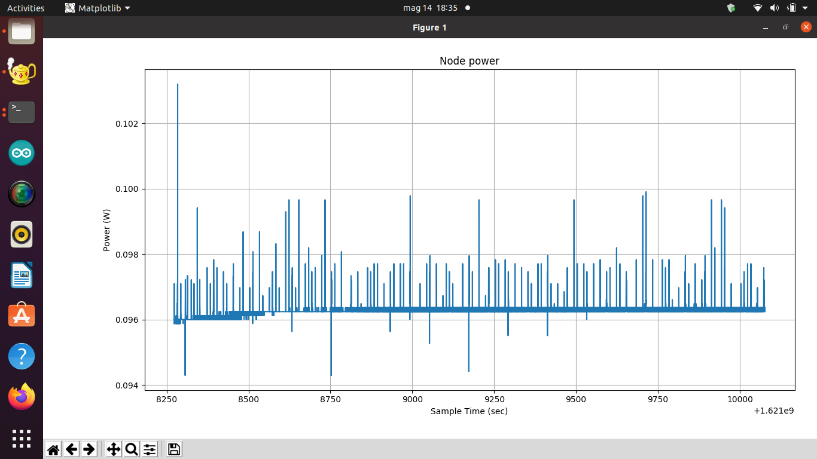
MEDIUM POWER CONSUMPTION mode

Slide 21
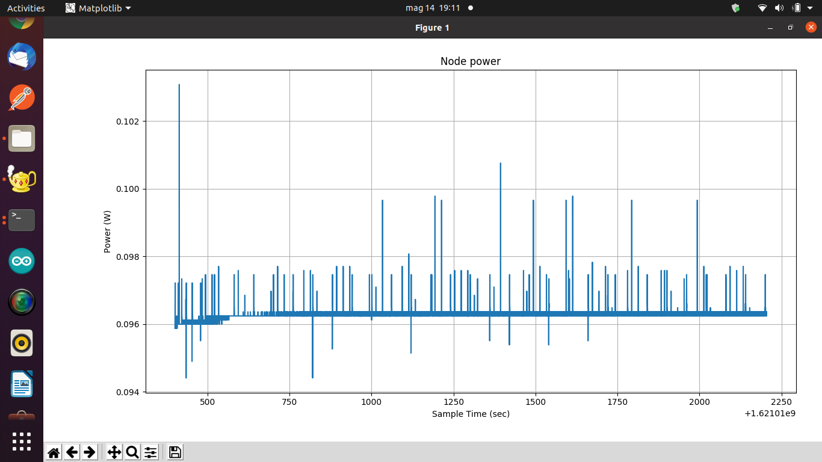
LOW POWER CONSUMPTION mode

Slide 22
EVALUATION IN THE REAL LIFE ENVIRONMENT
We decided to measure the power consumption using a multimeter
We kept running the floater for 5 minutes for each power consumption mode
For the power supply we used a powerbank
We simulated a boat that crossed the safety line every 30 seconds
The three attempts have been done consecutively.

Slide 23
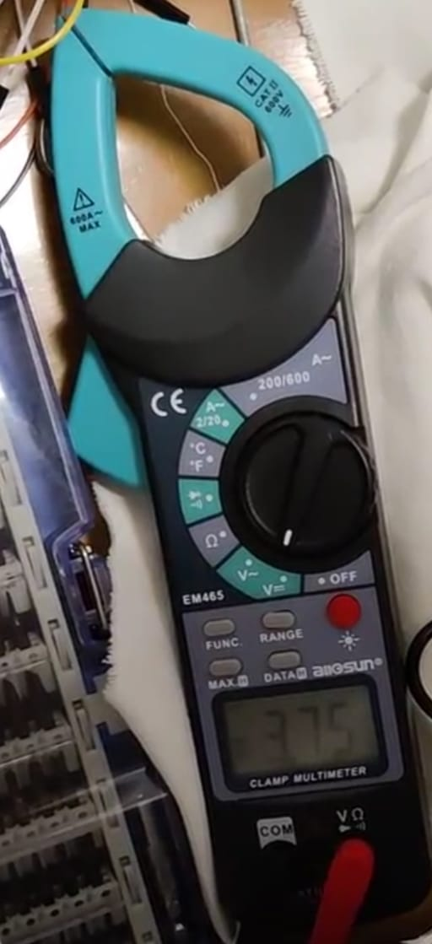
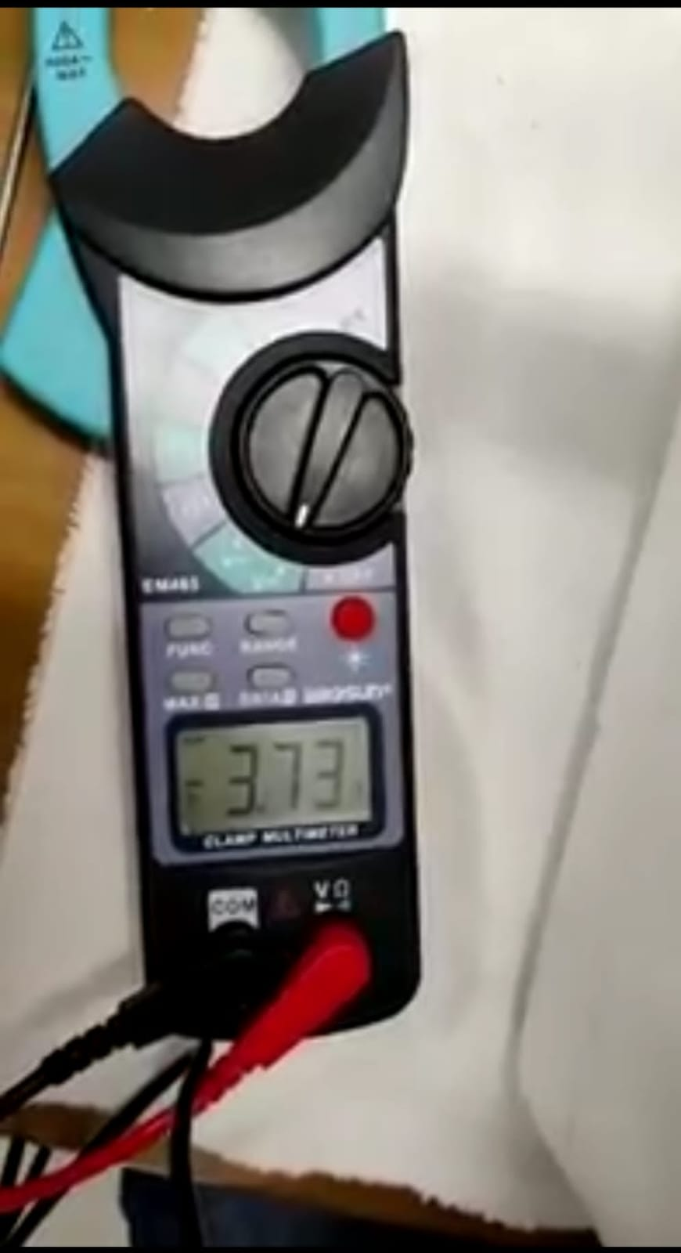
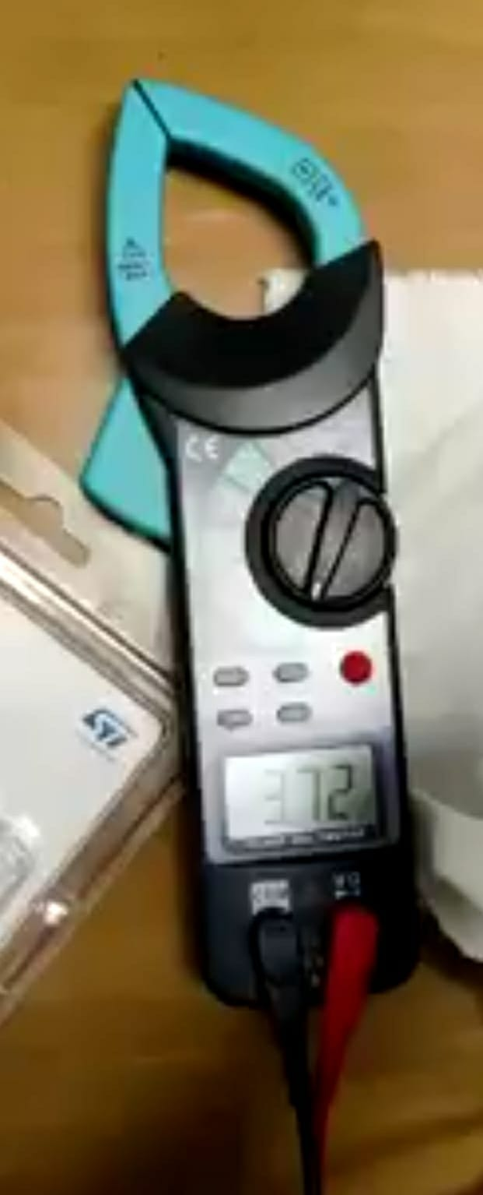
EVALUATION IN THE REAL LIFE ENVIRONMENT
HIGH MODE
MEDIUM MODE
LOW MODE
Starting Voltage: 3,80 V
Final Voltage: 3,75 V
Power Consumption: 50 mV: 10 mV per minute
15 hours using a 9V battery without considering solar panel
Starting Voltage: 3,75 V
Final Voltage: 3,73 V
Power Consumption: 20 mV: 4 mV per minute
38 hours using a 9V battery without considering solar panel
Starting Voltage: 3,73 V
Final Voltage: 3,72 V
Power Consumption: 10 mV: 2 mV per minute
79 hours using a 9V battery without considering solar panel

Slide 24
SEA STATION
4 m
4 m

Slide 25
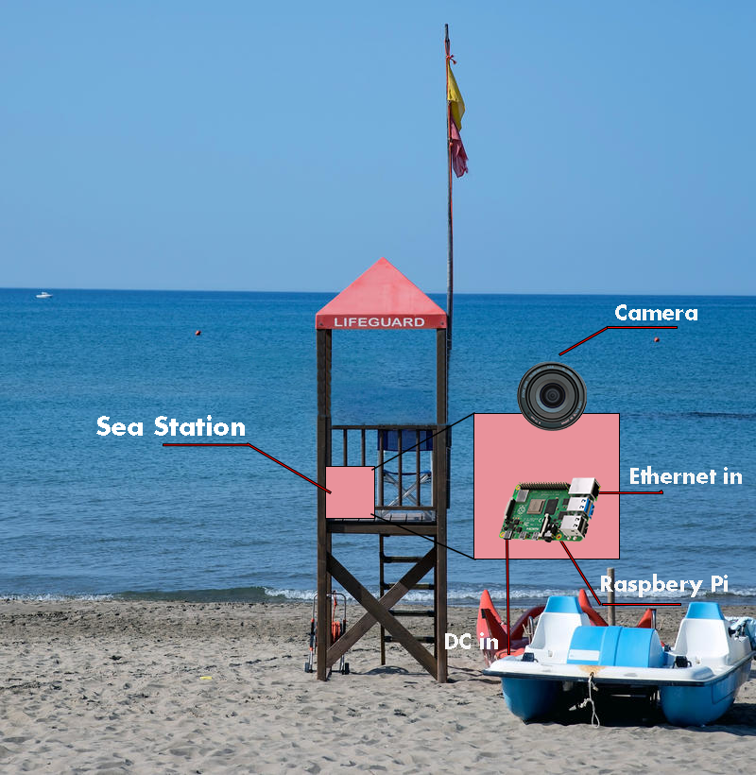
SEA STATION VIEW
Sea Station positioned in order to have the best view
Sea Station needs to have access to Internet and to eletrical power

Slide 26
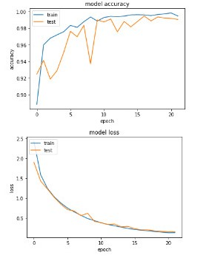
Evaluation & PERFORMANCE: boat detection
The dataset used is ARGOS
Model is trained on 2 classes: boat and no boat
The accuracy is about 0.98 on the test set

Slide 27
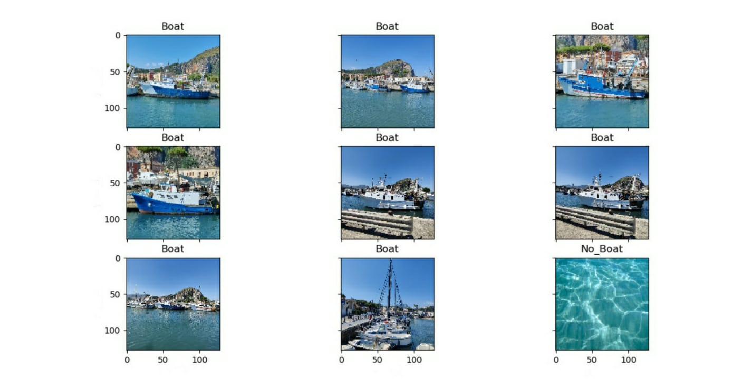
REAL LIFE EVALUATION WITH THE CNN

Slide 28
NETWORK latency
For our prototype we used a Bluetooth module in order to achieve an accurate measure of the latency, while we will have a LoraWan communication in a possible final version of the product
The estimation of boat recognition by Raspberry pi latency is made of an average based on timestamps
0
3
7
11
BUOY ID
GPS LAT
GPS LONG
Buoy ID is an Integer, Gps latitude and longitude are Floats

Slide 29
Evaluation & PERFORMANCE: NETWORK latency
I2C: STM->ARDUINO (0.001 S)
BLUETOOTH: ARDUINO->RASPBERRY (0.150 S)
PHOTO: RASPBERRY (3.000 S)
MQTT: RASPBERRY->CLOUD (0.050 S)
REST: CLOUD ->NODE (0.050 S)
REPORT AVAILABLE ON THE DASHBOARD (3.251 S)
I2C: STM->ARDUINO (0.001 S)
I2C:ARDUINO->STM(0.001 S)
Delay to detect false positive 1.000 S
I2C: STM->ARDUINO (0.001 S)
I2C:ARDUINO->STM (0.001 S)
BUZZER ACTIVATED (1.004 S)
FINAL ESTIMATED TIME: 1.004 S + 3.251 S = 4.255 S

Slide 30
NETWORK latency with lorawan
I2C: STM->ARDUINO (0.001 S)
LORAWAN: ARDUINO->RASPBERRY (1.051 S)
PHOTO: RASPBERRY (3.000 S)
MQTT: RASPBERRY->CLOUD (0.050 S)
REST: CLOUD ->NODE (0.050 S)
REPORT AVAILABLE ON THE DASHBOARD (4.152 S)
I2C: STM->ARDUINO (0.001 S)
I2C:ARDUINO->STM(0.001 S)
Delay to detect false positive 1.000 S
I2C: STM->ARDUINO (0.001 S)
I2C:ARDUINO->STM (0.001 S)
BUZZER ACTIVATED (1.004 S)
We considered 868 MHz, duty cycle 1% and SF12
FINAL ESTIMATED TIME: 1.004 S + 4.152 S = 5.156 S

Slide 31
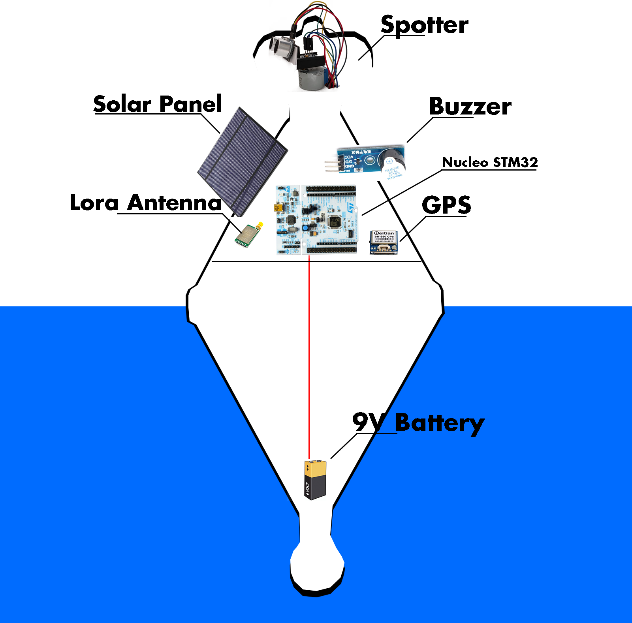
Future development
Optimizing power management
Introduction of LoraWan
Improving latency
Development of a better web interface
Introduction of Solar panel
Use a better gyroscope, if possible

